Slide 1
ROADSTER CORP NETWORK OPTIMIZATION PLAN
Project Requirement
Approaches
Proposed Business Solution
Resource and Budgetary Requirements
Security and Performance Concerns

Slide 2
Project Requirements
Roadster Corp is a multinational car manufacturer facing an increased demand
There has been a need to increase the number of branches and regional offices to meet the growing demand
Currently, the company has 15 strategic locations
There is a plan to establish 3 additional branches to harness service-delivery
Consequently, there has been a need to manage, optimize, and troubleshoot the existing MIS Network

Slide 3
Project Requirements (Cont..ed)
The three project requirements include;-
Achieving seamless coordination of the existing project servers and user applications
Using MIS integration project to create sustainable value for the stakeholders
Continuous focus on creating business solutions
The pertinent project requirements aim to align the project resources with the corporate objectives

Slide 4
Identified Project Plans
Four planning approaches have been identified to streamline the project resources with corporate objectives;-
Human Resource Plan
Material-Asset Plan
Budget Plan
Risk Management Plan
The four plans influence the resource-utilization strategies and approaches

Slide 5
Proposed Business Solutions
Resource Allocation Plan facilitates adequate tradeoff of the scarce resources
Besides, the allocation plan also influences the timing of the need and types of resources
The MIS integration project hinges on the functional teams
Material-Asset Plan focuses on availing necessary material goods
The Material-Asset Plan results in saving on cost, eradicate delays, and achieve value for the investment

Slide 6
Proposed Business Solutions
Budget Plan also provides fundamental business solutions.
Mobilization of financial resources
Offsets the obligations
Project administrator need to budgetary skills to establish the cost of each milestone
Risk Management Plan influences a host of strategic options
The four identified strategies aim to handle the risks during the pre-implementation, execution, and post-implementation phases

Slide 7
Resources and Budgetary Requirements
HARDWARE | SOFTWARE | TECHNOLOGY
CISCO CSS-11500 service switches series | SAP ERP X3 Sage Group | Database Management System (DBMS)
CISCO 1921-Routers ISR-G2 model | SAP ASE Database Management System
8-GHZ Server suite |  | Mail Services Management (MSM)
HP Elite-One 800-G2 workstation | Yale Group Mail Software (Annual subscription) | Enterprise Resource Planning System (ERP)
Artis PS-600VA UPS
PC-Cooler 12V-LED computer case
ESPON Printers

Slide 8
Resources and Budgetary Requirements
The expanded MIS Network utilizes the existing infrastructures
The key ICT infrastructures include the hardware peripherals, software components, and technologies used
Other resources;-
IT Security Policy
IT Legislations
Data Backup Modules

Slide 9
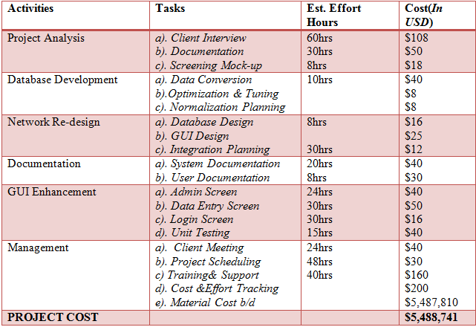
BUDGETARY ALLOCATION PLAN

Slide 10
Security and Performance Concerns
The current MIS Network has experienced series of intrusion and breaches in the last 10 years
Achieving adequate Integrity Control is a pertinent security concern
Need for a multi-dimensional approach that include;-
Authentication Capabilities
Control Points using VPN, Firewalls, and Encryption Keys
Core objectives include safeguarding the safety of company assets, integrity of information, and improve the operational standards

Slide 11
Performance Concerns for MIS-Network
The new MIS –Network has an obligation to ensure uninterrupted performance
The new MIS-Network incorporates two safeguards
Backup System
Performance-Audit Trail
Data Backup Module aligns with the conventional IT policies on performance
Guarantees continuity during system failure or during the maintenance period
Performance-audit Trail tracks the history activities, identify errors, and enforce users’ accountability

Slide 12
References
Keast, R., Mandell, M. & Agranoff, R. (2013). Network theory in the public sector: Building new theoretical frameworks, New York, NY: Routledge
Loudon, J. & Loudon, K. (2014). Management information system: Managing digital firm, (13 Ed.) Boston; MA, Pearson
Weedmark, D. & Seidel, M. (2019, January 31). “Five things to be considered in designing a network,” The SmallBusiness Chron
Doraiswamy, P. & Shiv, P. (2012). 50 top IT project management challenges, Ely, Cambridgeshire: IT Governance Pub.
Jonasson, H. (2007). Determining project requirements: The best practices and tips, Atlanta, GA: Project Management Institute

